Slide 1
Staplers and GUNS
Dr TULIP

Slide 2
Available in the Market
Covidien
Meril
Johnson and Johnson
Lotus

Slide 3
Cartridge
Colour - Staple length
Cartridge length

Slide 4
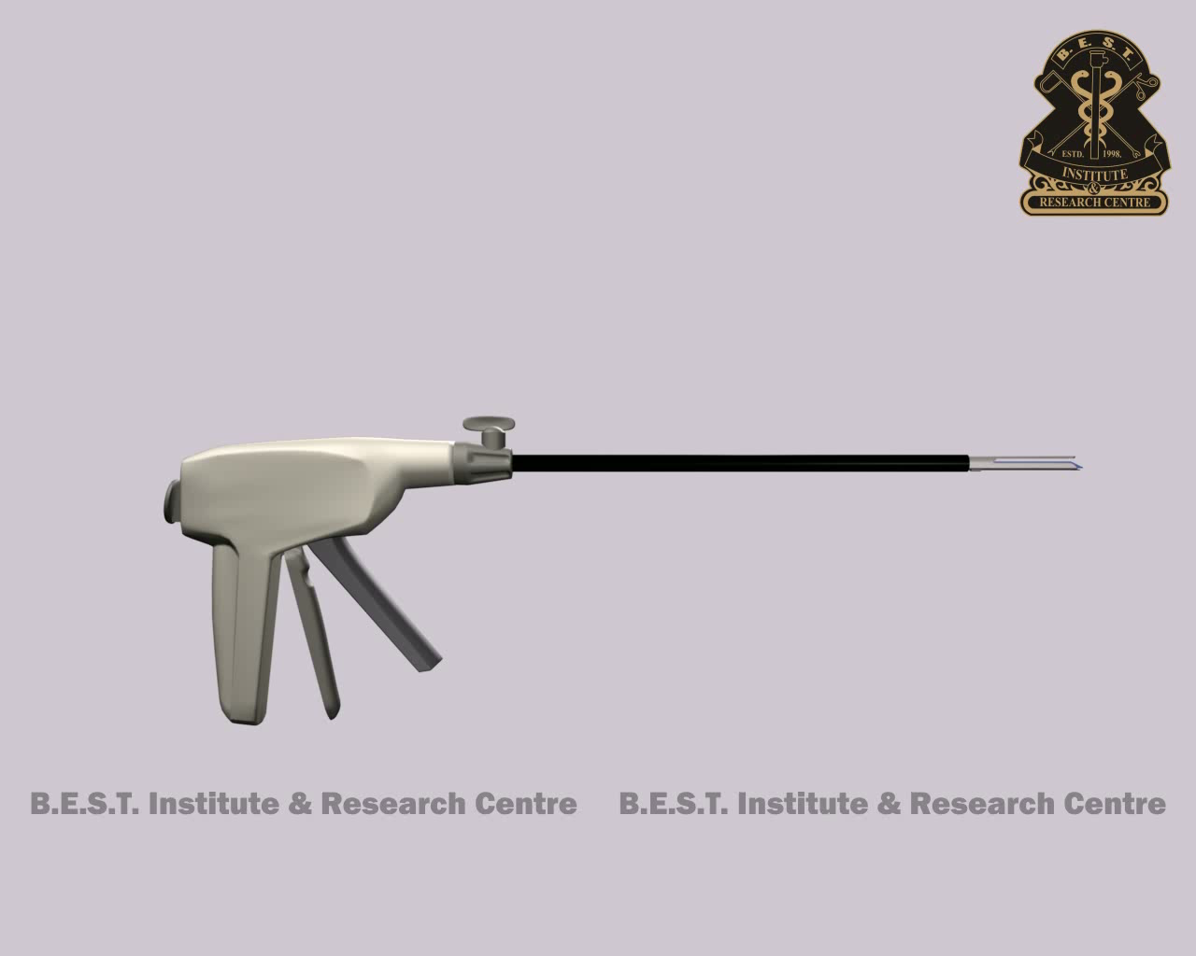
Working of a cartridge

Slide 5

Single pin animation

Slide 6
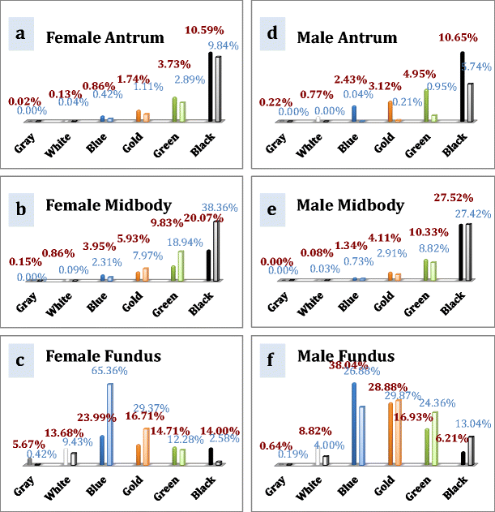

Slide 7
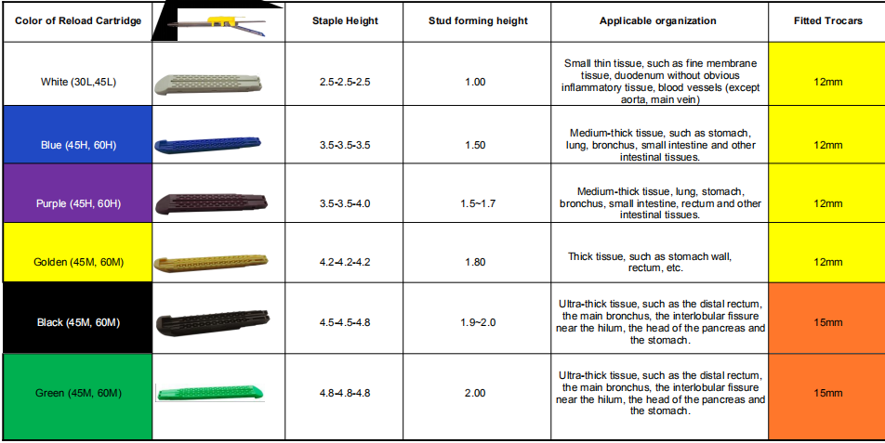

Slide 8
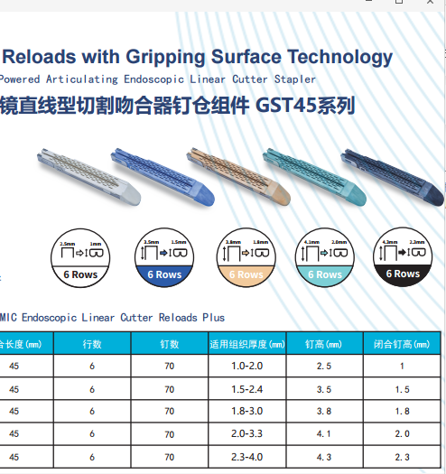

Slide 9
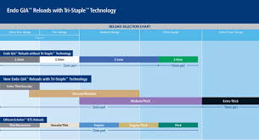

Slide 10
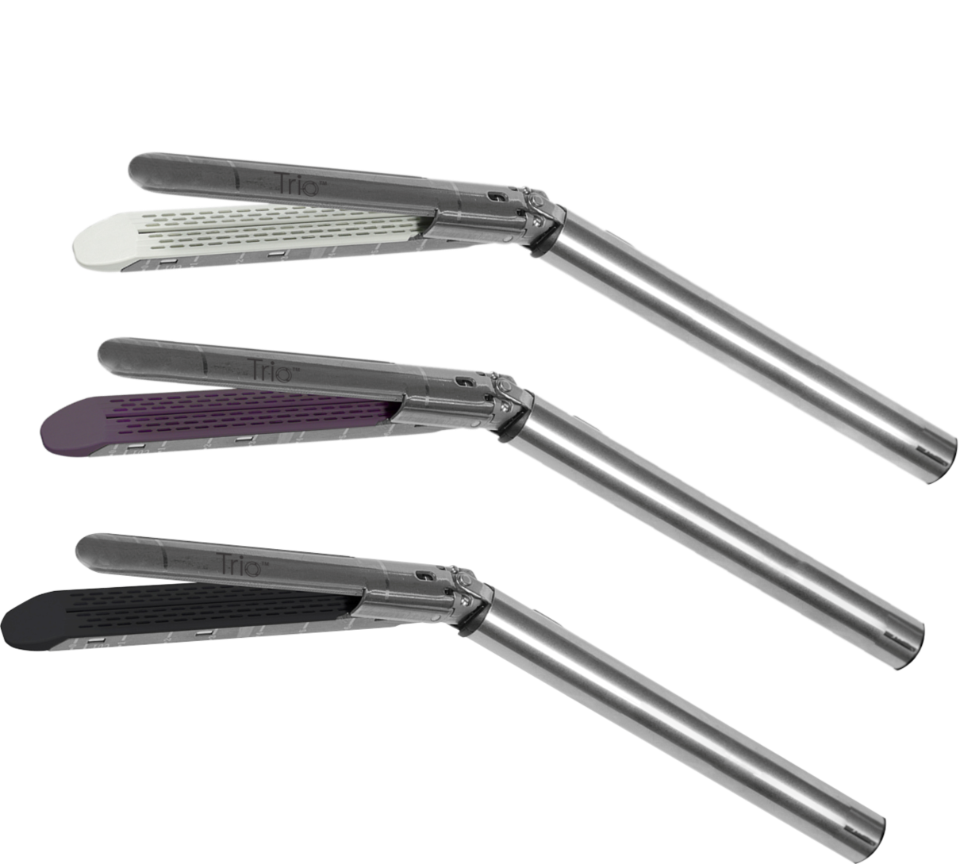
Meril Reloads

Slide 11
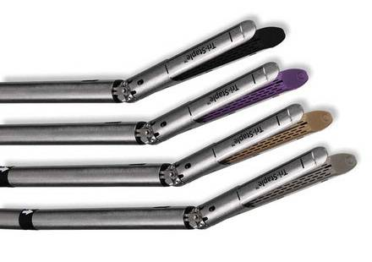
Covidien Tristapler Reloads

Slide 12
Other cartridges

Slide 13
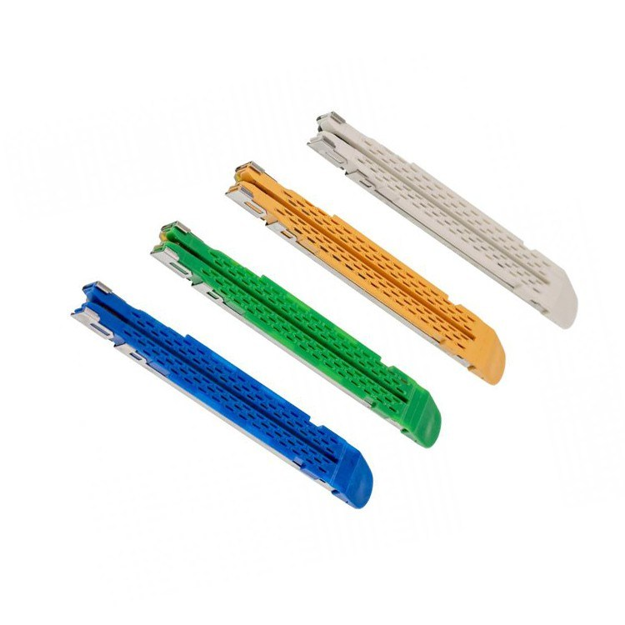
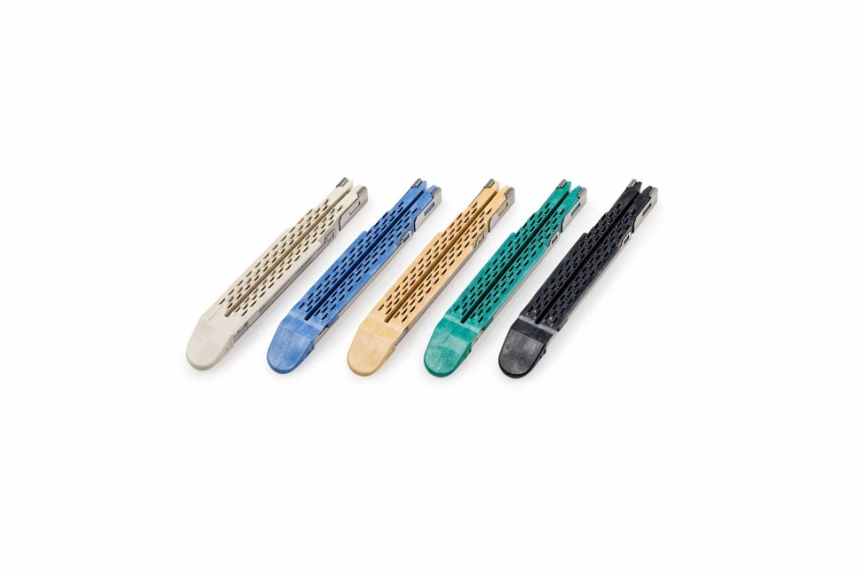
J and J reloads

Slide 14
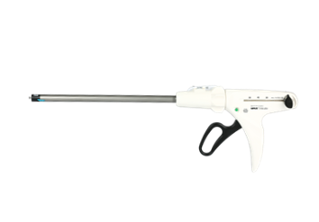
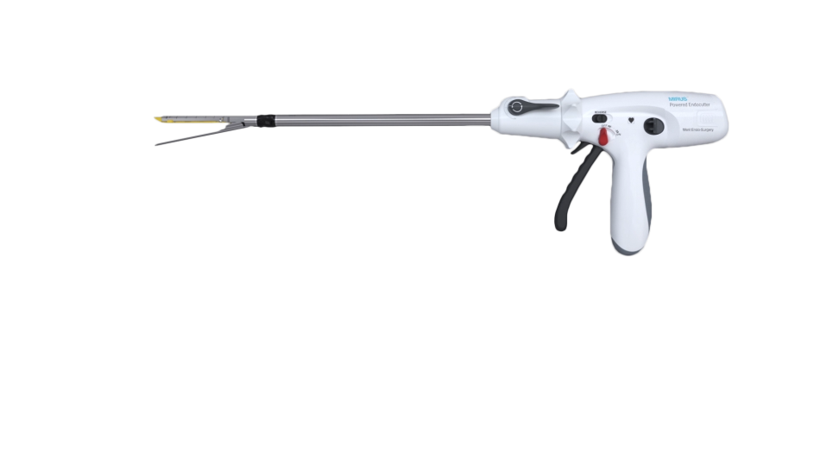
Meril

Slide 15
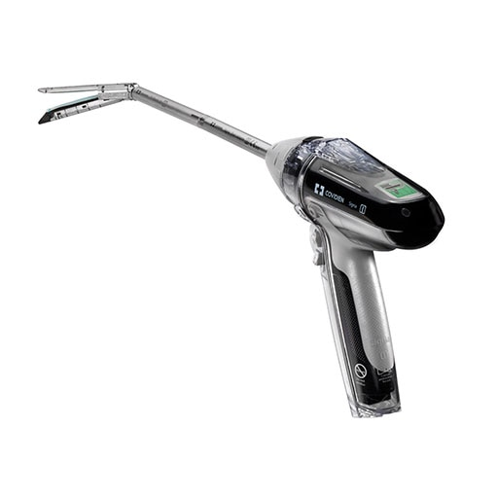
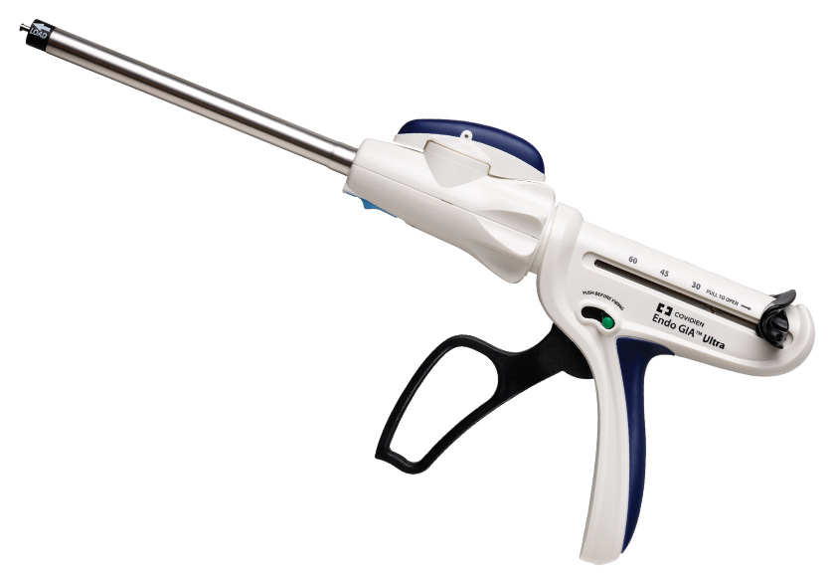
Covidien

Slide 16
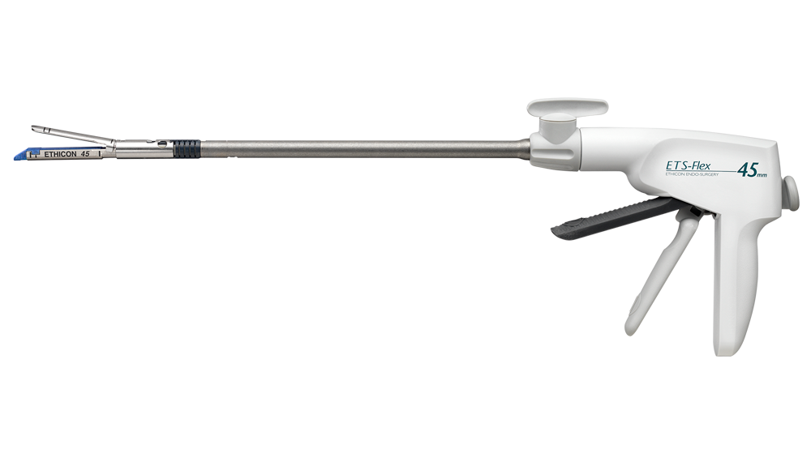
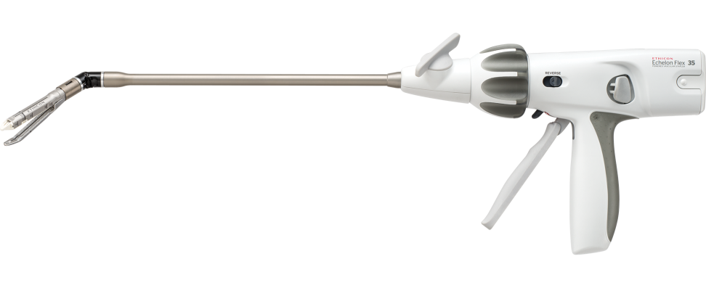
Johnson and Johnson

Slide 17
Choice of cartridges
Stomach
Intestine
Vessel
Redo surgeries

Slide 18

Seam Guard

Slide 19
Suture material
2-0 PDS, Maxon
2-0 Prolene, Maxon
3-0 PDS, Maxon
3-0 Prolene

Slide 20
Endosuturing
Conventional
Endostitch
2-0 PDS, Maxon
2-0 Prolene, Maxon
3-0 PDS, Maxon
3-0 Prolene
Surgidac
Polysorb

Slide 21
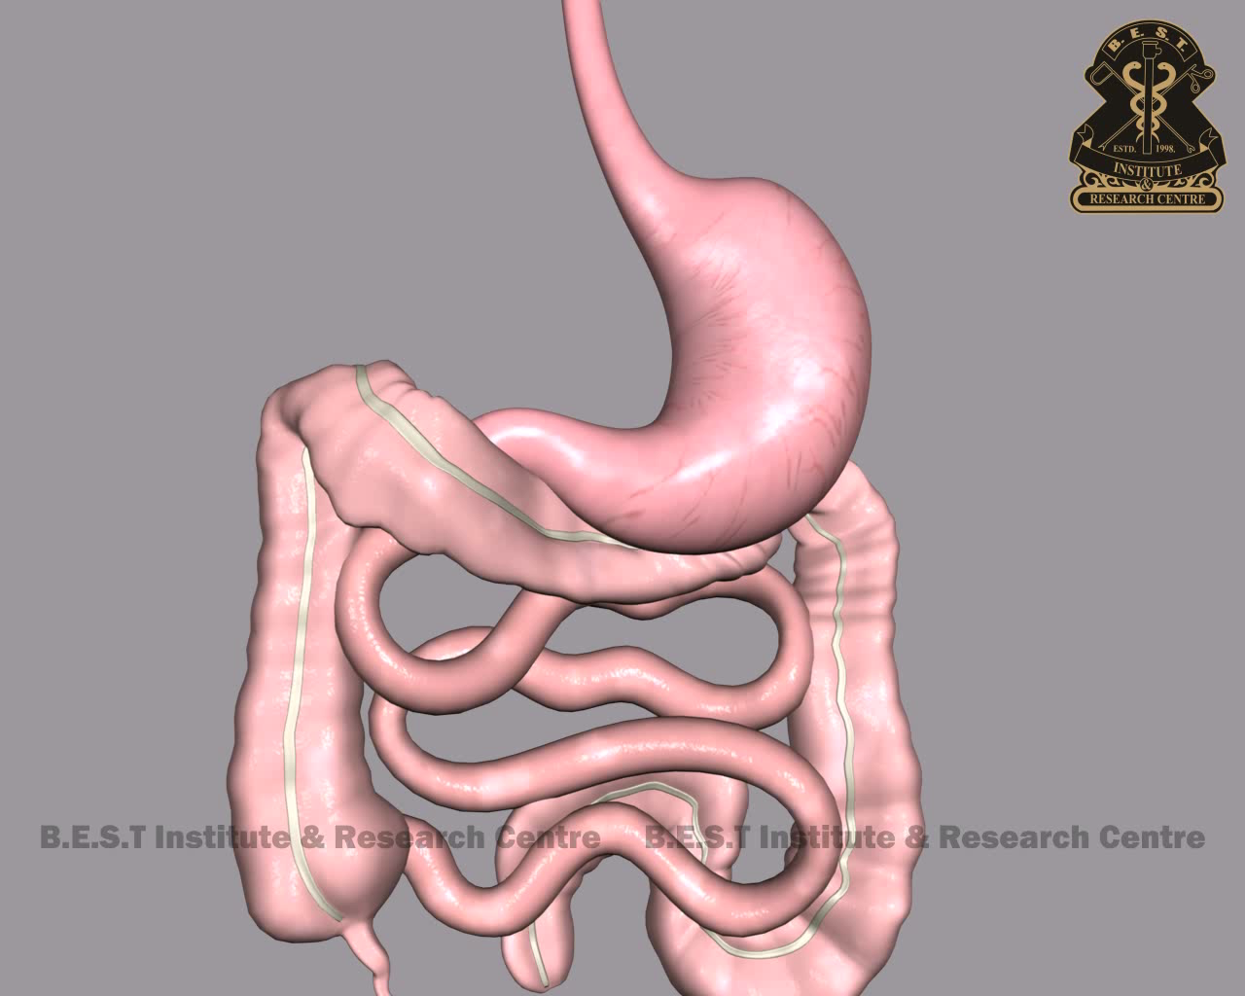
Leak test After SG

Slide 22
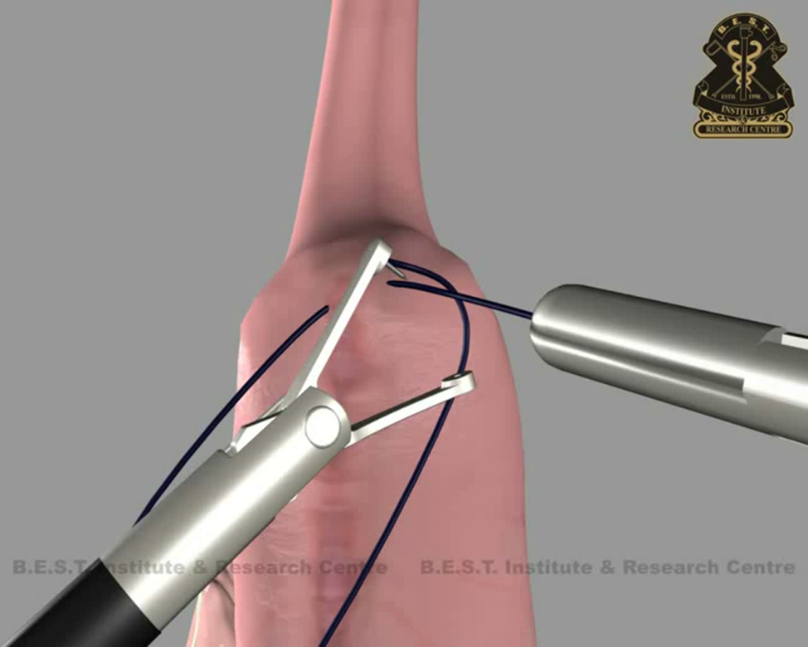
Endostitch

