Slide 1
Instruments in Bariatric Surgery
Dr Tulip

Slide 2
Trocars
Reusable and Disposable
Regular and Bariatric length
Reusable 10mm and 5mm
Reusable 3 in one
15mm /12mm disposable

Slide 3
Bowel graspers
Bariatric length

Slide 4


Bariatric Pencil grip Graspers
Crocodile
Duckbill

Slide 5
Hormonic Ace

Slide 6
Bariatric length
Monopolar hook : LC
Bipolar forceps
Hormonic Ace
Suction Cannula
Needle holders

Slide 7
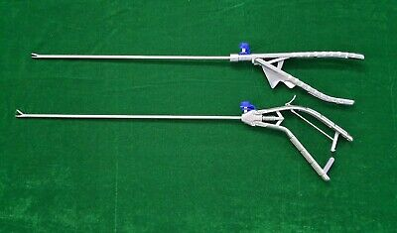
Needle holder

Slide 8

Calibration Tubes

Slide 9
Goldfinger

Slide 10
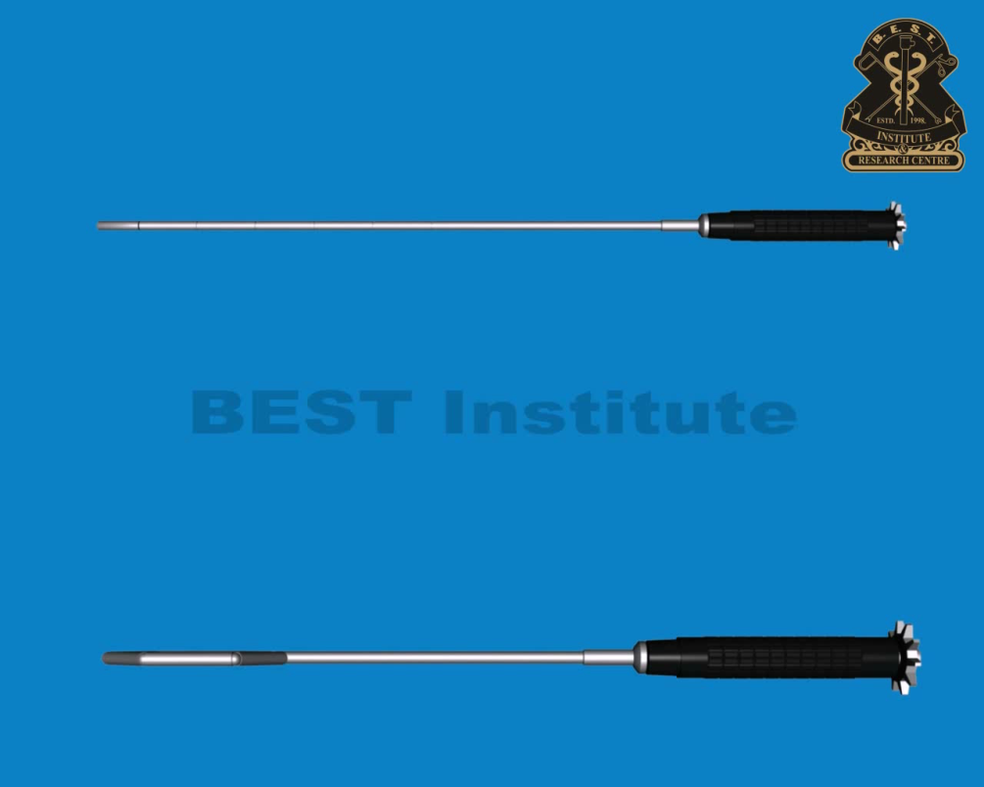
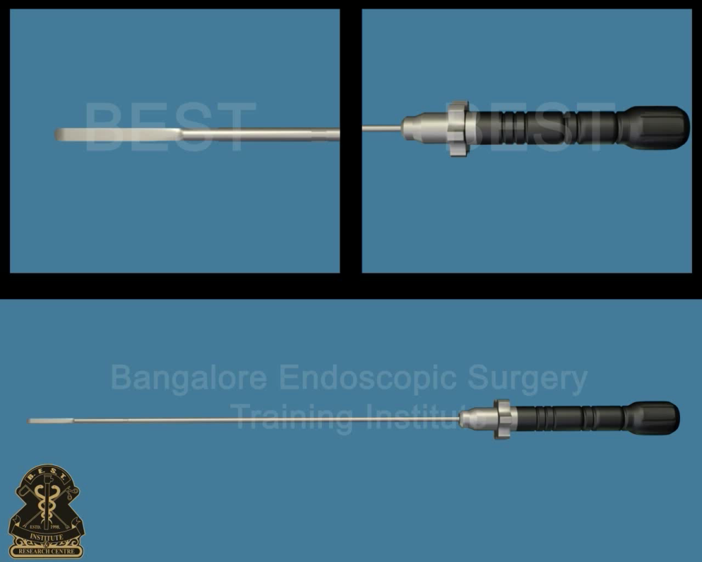
Liver retractor

Slide 11
